Slide 1
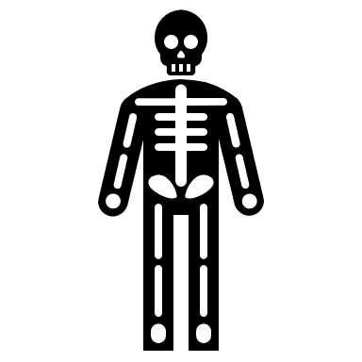
Joints
GTHBY Human Biology

Slide 2
Review
1. How do bones grow?
2. Give an example of a long bone, a short bone, a flat bone, an irregular bone and a sesamoid bone.
3. Give an example of a specialist receptor and a general receptor.
4. Which divisions of the nervous system are involved in ‘rest and digest’ functions, such as slowing heart rate?

Slide 3
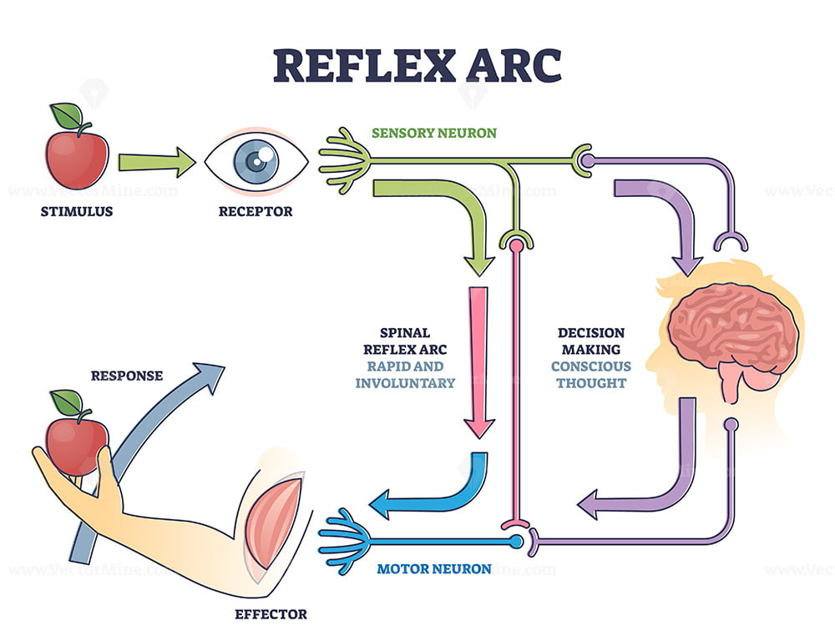
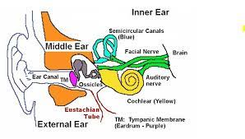
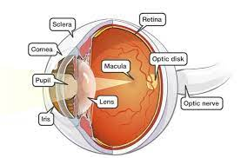

Slide 4
Learning Intentions
Function of joints in terms of support and movement
Types of joints and the range of movement they permit, including immovable, cartilaginous, hinge, pivot, gliding and ball and socket
General structure of synovial joints
Location of different joints in the human body

Slide 5
Success Criteria
List the functions of joints.
Classify joints by movement/shape
Label an anatomical diagram of a synovial joint
Give examples of each type of joint and locate them in the body.

Slide 6
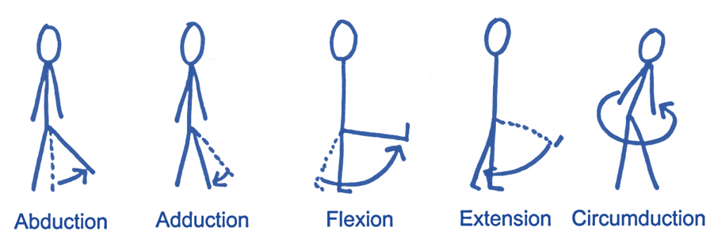
Function of joints
Joints connect bones. They provide stability to the skeleton, and allow movement. Joints permit a free range of movements such as flexion, extension, abduction, adduction and circumduction

Slide 7
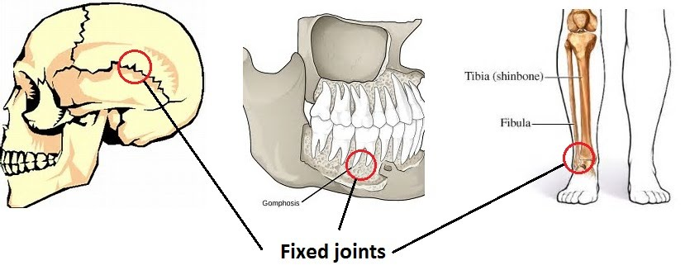
Immovable joint
tough fibres join bones so they are unable to move

Slide 8
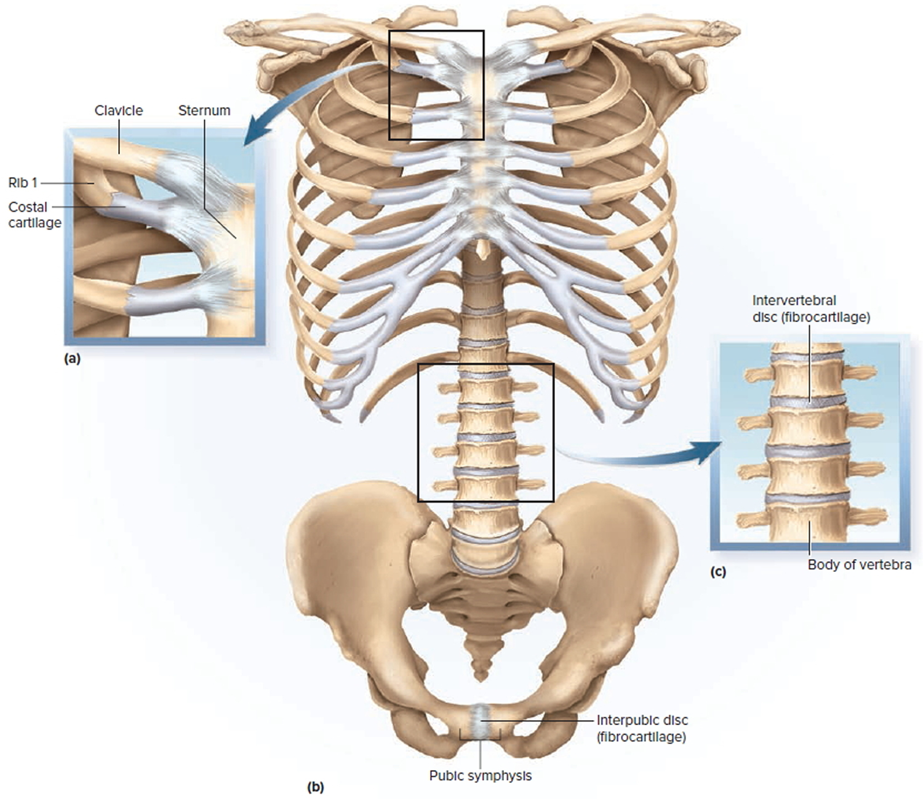
Cartilaginous joint
bones are connected entirely by fibrous or hyaline cartilage. These joints generally allow more movement than fibrous joints but less movement than synovial joints.

Slide 9
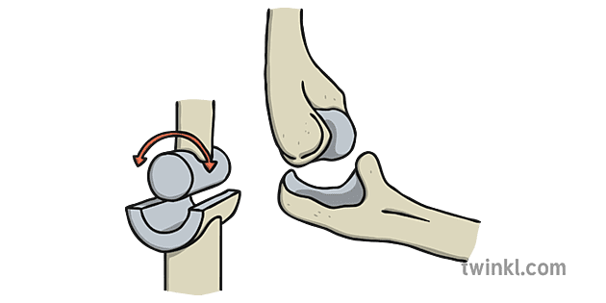
Hinge Joint
a type of synovial joint that allows motion primarily in one plane.

Slide 10
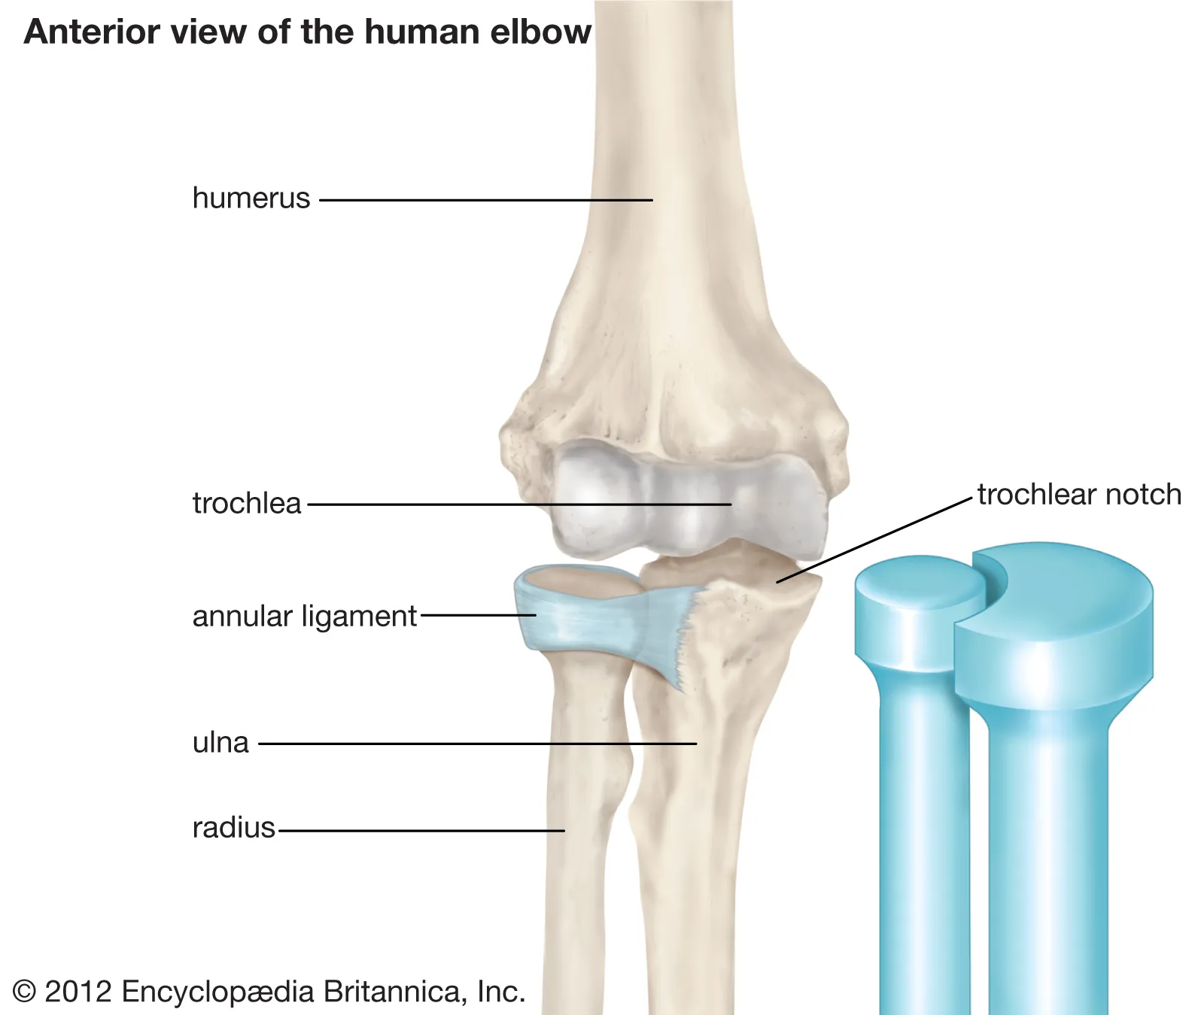
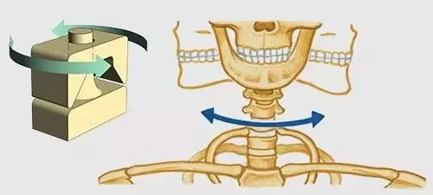
Pivot Joint
a freely moveable joint that allows only rotary movement around a single axis. The moving bone rotates within a ring that is formed from a second bone and adjoining ligament.

Slide 11
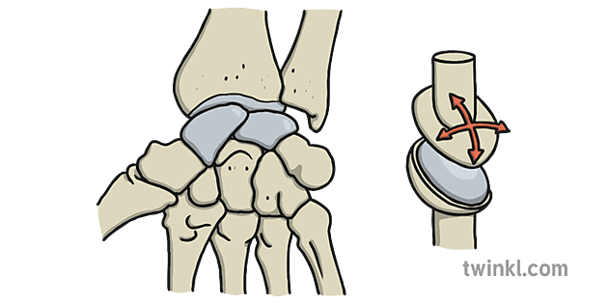
Gliding joint
the articulating surfaces of the involved bones are flat or only slightly curved and glide past one another

Slide 12
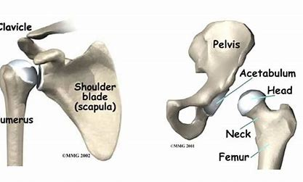
Ball and Socket
The most mobile type of
synovial joint, the end of one
bone is spherical, forming the ball, while the end of the other bone within the joint contains a rounded depression, forming the socket. The ball slides, rolls, and spins within the socket to allow movement of the joint in multiple directions.

Slide 13
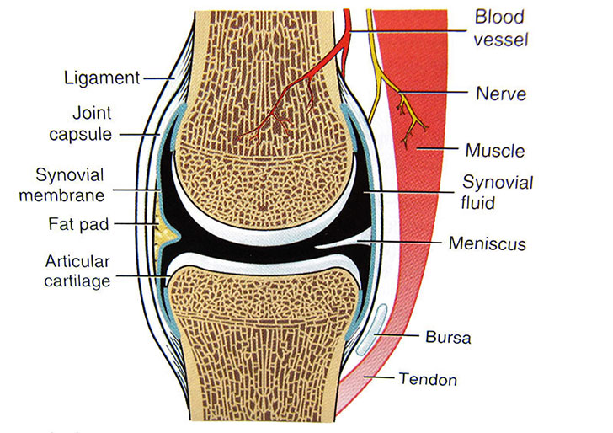
The Synovial Joint

Slide 14
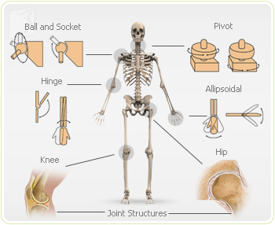

Slide 15
Success Criteria
List the functions of joints.
Classify joints by movement/shape
Label an anatomical diagram of a synovial joint
Give examples of each type of joint and locate them in the body.

